Slide 1

Naïve Bayes
By professor Dr. Scott

Slide 2
Classification
There exist 2 sets:
Mapping according to the rule of
For any
, there is only one
in which

Slide 3
Example
Doctor clinic
Observe Symptom to identify the diseases
- fever
- sneeze
- cough
cold

Slide 4
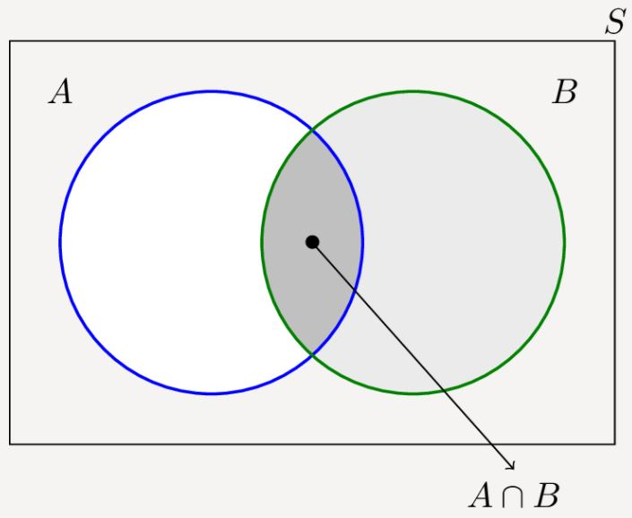

Naïve Bayes Classifier
。

Slide 5

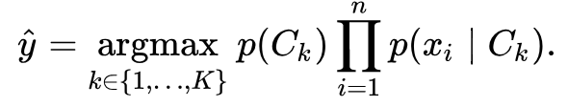
Assume this picture is 4K clear
Assuming each x is independent to each other

Slide 6

Gaussian distribution
Multinomial: discrete value
Bernoulli: binomial value

Slide 7
Laplace Correction
P(a|y)=0
Add 1 instance in that class

Slide 8
Example
Person | height (feet) | weight (lbs) | foot size(inches)
male | 6 | 180 | 12
male | 5.92 (5'11") | 190 | 11
male | 5.58 (5'7") | 170 | 12
male | 5.92 (5'11") | 165 | 10
female | 5 | 100 | 6
female | 5.5 (5'6") | 150 | 8
female | 5.42 (5'5") | 130 | 7
female | 5.75 (5'9") | 150 | 9

Slide 9
Person | mean (height) | variance (height) | mean (weight) | variance (weight) | mean (foot size) | variance (foot size)
male | 5.855 | 3.5033*10⁻² | 176.25 | 1.2292*10² | 11.25 | 9.1667*10⁻¹
female | 5.4175 | 9.7225*10⁻² | 132.5 | 5.5833*10² | 7.5 | 1.6667
Person | height (feet) | weight (lbs) | foot size(inches)
sample | 6 | 130 | 8

Slide 10
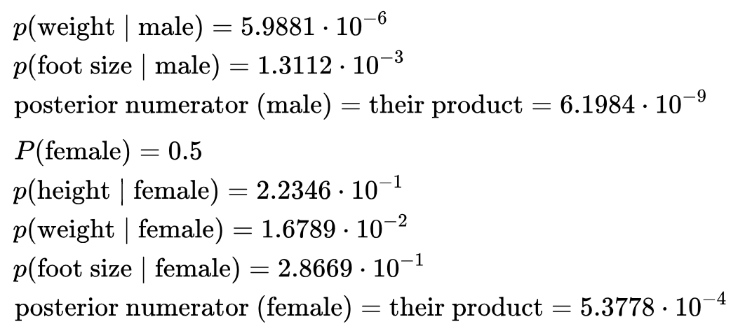
Predict result: female

Slide 11
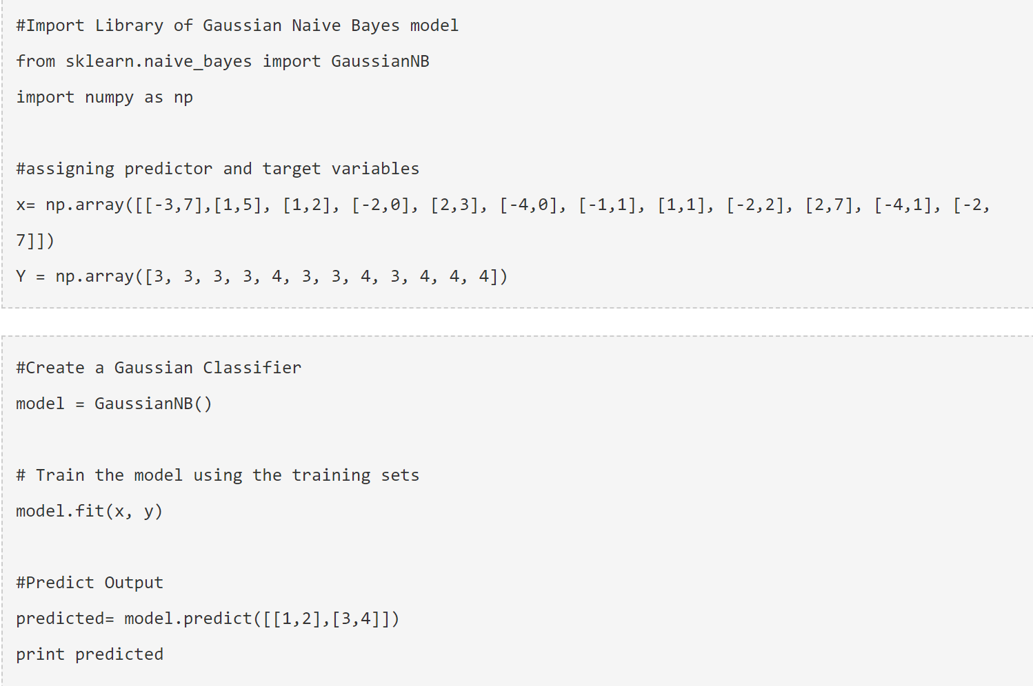
Python code

Slide 12
Application and problem
Application:
1. Real time prediction
2.Multi-class prediction
3. Word prediction (Spam-email classifier)
4.Recommendation system
Problem:
Pre-requisite: All feature independent to each other
Accuracy not good enough
Boosting, Bagging, ensembling won’ help improving result
Feature selection and pre-processing is needed

Slide 13
Reference:
https://www.analyticsvidhya.com/blog/2017/09/naive-bayes-explained/
http://www.cnblogs.com/leoo2sk/archive/2010/09/17/naive-bayesian-classifier.html
https://en.wikipedia.org/wiki/Naive_Bayes_classifier

